Slide 1
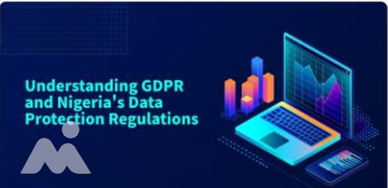

September 2025

Slide 2


INTRODUCTION
Data privacy is a global priority. Both
GDPR (EU law) and NDPR (Nigeria’s
regulation) ensure customer data is
collected, processed, and stored
responsibly.
NDPR (Nigeria Data Protection Regulation)
governs the use and protection of
personal data in Nigeria, while GDPR
(General Data Protection Regulation)
regulates the use and protection of
personal data across European Union
member states.
Relevance to Olive Monies: As an
international money transfer operator,
compliance builds customer trust and
regulators as well as supports secure cross-border remittances

Slide 3




GDPR AND NDPR REGULATION AWARENESS TRAINING OBJECTIVES
01
Core principles of Data protection.
02
Personal data and what constitutes personal
03
data subject rights, data breach and reporting
04
Legal bases for processing Personal data
05
Data controller,data processor and breach penalties

Slide 4
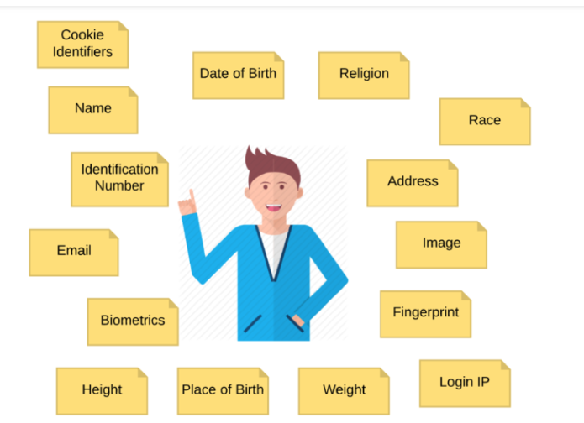
What is Personal Data?
Personal Data is any information that relates to an identified or identifiable individual, either directly (e.g., name, ID number) or indirectly (e.g., location data, online identifier).

Slide 5
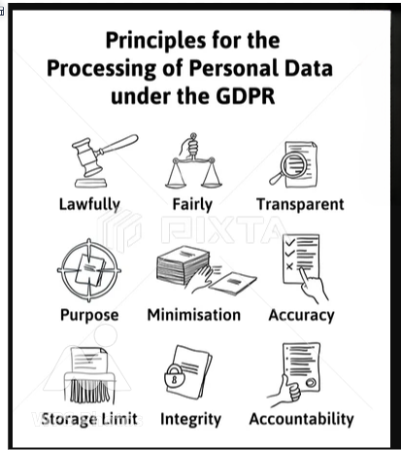

Slide 6
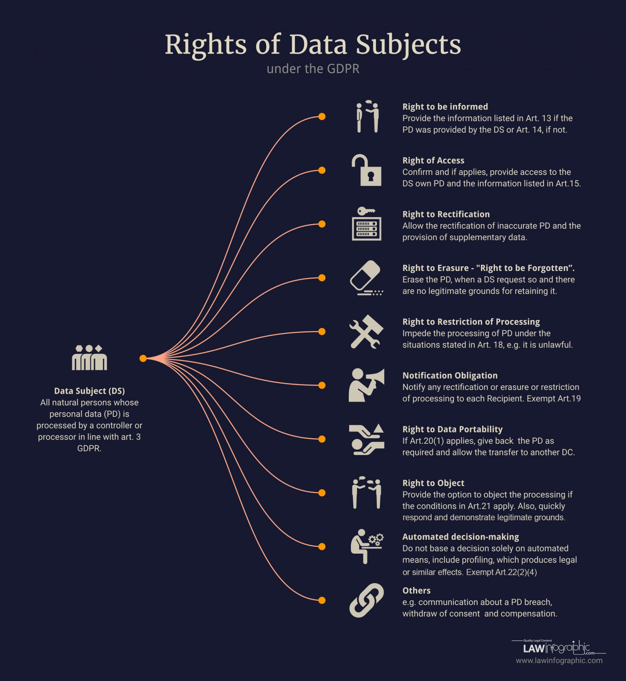

Slide 7
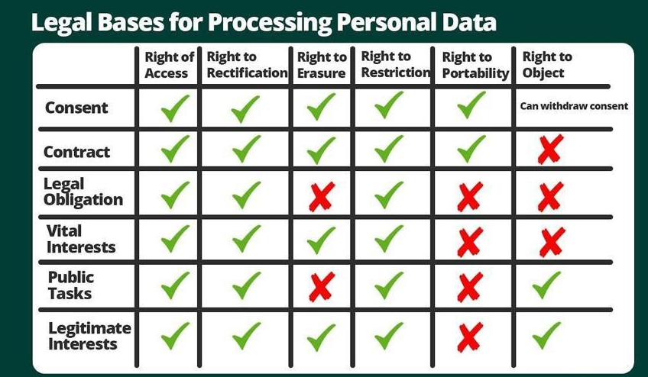

Slide 8
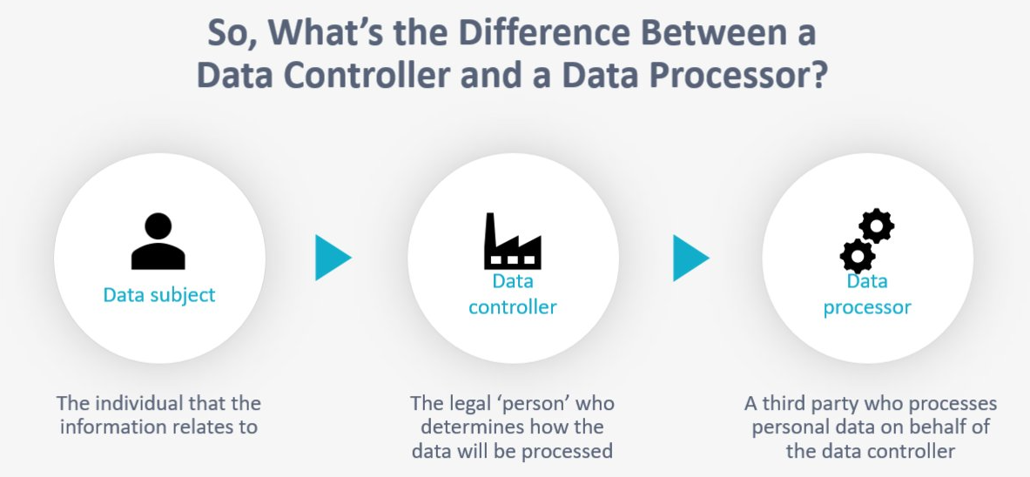

Slide 9
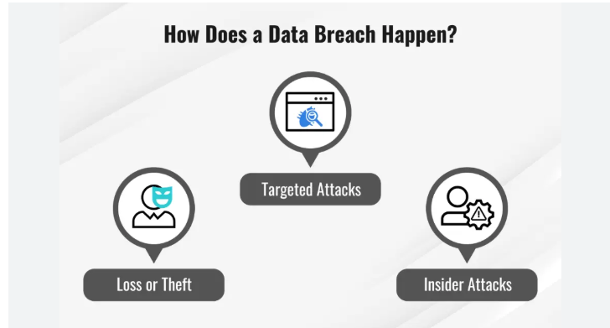
A data breach occurs when sensitive, confidential, or protected information is accessed, disclosed, or used without authorization.
Examples:
An employee accidentally emails customer banking details to the wrong recipient.
Hackers gain unauthorized access to a company’s database and steal customer personal information.

Slide 10
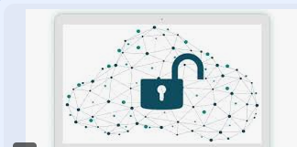
What to Do When a Data Breach Occurs
Olive Monies Express’ customer database gets hacked, and some customers’ emails and details are exposed.
Here’s what we should do:
Contain – Immediately close access to the compromised server.
Assess – Find out which data was accessed and how.
Notify – Inform the NDPC within 72 hours.
Inform customers – Send emails to affected customers explaining what happened and advise them to change passwords.
Fix – Improve firewalls, enforce two-factor authentication, and train staff.

Slide 11
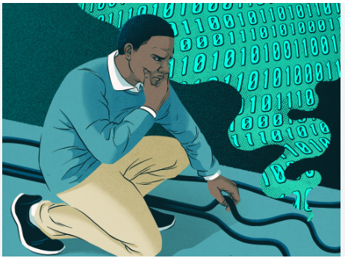
🚫 What Not to Do During a Data Breach
Don’t hide or delay reporting it
Trying to cover it up or waiting too long can make the damage worse and attract penalties.
Example: Waiting a week before informing NDPC instead of reporting within 72 hours.
Don’t delete or alter evidence
You’ll need the logs and records to investigate what really happened.
Example: Wiping the server immediately before IT can trace the source.
Don’t blame individuals publicly
Handle the situation professionally — avoid pointing fingers until facts are confirmed.
Don’t notify customers without facts
Only contact affected people after confirming what data was actually exposed — avoid panic or confusion.
Don’t continue business as usual
Pause any risky operations until the breach is contained.

Slide 12
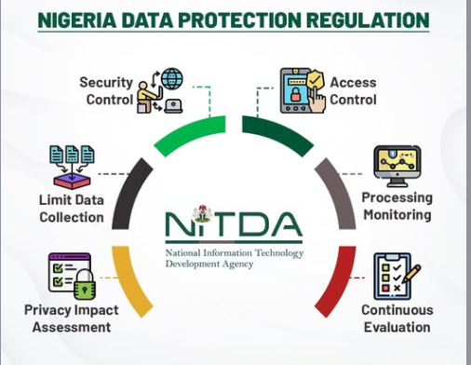
Key Controls under Data Protection Regulation (NDPR/GDPR)

Slide 13
Major Data Privacy Breaches: Multichoice and Fidelity Bank Fined Heavily
Multichoice:
The Nigeria Data Protection Commission (NDPC) fined Multichoice ₦766,242,500 for illegally transferring Nigerians’ personal data across borders and adopting intrusive, unfair, and disproportionate data processing practices, in violation of the Nigeria Data Protection Act (NDPA).
Despite being ordered to implement remedial steps, NDPC found the company’s response unsatisfactory and placed all Multichoice data-collection outlets under heightened scrutiny, warning of further severe penalties for continued non-compliance.
Fidelity Bank:
In a separate case, Fidelity Bank Plc was fined ₦555,800,000 by the NDPC in August 2024 for processing customers’ personal data without informed consent — including misuse of cookies and mobile banking tools.
The fine, representing 0.1% of the bank’s 2023 gross revenue, was increased due to the bank’s lack of cooperation and “arrogant disposition” during the investigation. Fidelity Bank disputed the findings, insisting no breach occurred.

Slide 14
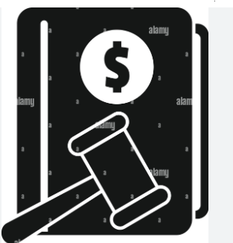
NDPR (Nigeria) vs GDPR (EU) – Penalties Comparison
Category | NDPR / NDPA 2023 (Nigeria) | GDPR (EU)
Regulator | Nigeria Data Protection Commission (NDPC) | European Data Protection Board (EDPB)
Minor Violations | Up to ₦2 million or 2% of annual gross revenue, whichever is higher | Up to €10 million or 2% of annual global turnover, whichever is higher
Major Violations | Up to ₦10 million or 2% of annual gross revenue, whichever is higher (for major controllers/processors) | Up to €20 million or 4% of annual global turnover, whichever is higher
Examples of Violations | Failing to secure data, no consent for processing, ignoring data subject rights | Unlawful data sharing, delayed breach reporting, no legal basis for processing
Enforcement Authority | NDPC (formerly NITDA) | National Data Protection Authorities in EU member states

Slide 15
CONCLUSION
At Olive Monies, protecting personal data is not just about compliance—it is about trust. By handling customer information lawfully, securely, and transparently, we safeguard our customers, meet regulatory expectations, and strengthen our reputation as a reliable international money transfer service.

Slide 16
Thank You

